Slide 1
Searching Algorithms
Will Present You:
Miraga Aliyev – Fibonacci Search;
Zivar Hasanova – Jump Search;
Gunel Khanaliyeva– Binary Search;
Javidan Alizada – Ternary Search;

Slide 2
Searching Algorithms
Fibonacci Search;
Fibonacci Search is a comparison-based technique that uses Fibonacci numbers to search an element in a sorted array.
Will Present You:
What is Fibonacci Numbers?
Miraga Aliyev – Fibonacci Search;
Zivar Hasanova – Jump Search;
Fibonacci Numbers are recursively defined as F(n) = F(n-1) + F(n-2), F(0) = 0, F(1) = 1. First few Fibonacci Numbers are 0, 1, 1, 2, 3, 5, 8, 13, 21, 34, 55, 89, 144
Gunel Khanaliyeva– Binary Search;
Javidan Alizada – Ternary Search;

Slide 3
Miraga Aliyev
Fibonacci Search;
Fibonacci Search is a comparison-based technique that uses Fibonacci numbers to search an element in a sorted array.
What is Fibonacci Numbers?
Fibonacci Numbers are recursively defined as F(n) = F(n-1) + F(n-2), F(0) = 0, F(1) = 1. First few Fibonacci Numbers are 0, 1, 1, 2, 3, 5, 8, 13, 21, 34, 55, 89, 144
Will Present You:
Miraga Aliyev – Fibonacci Search;
Zivar Hasanova – Jump Search;
Gunel Khanaliyeva– Binary Search;
Javidan Alizada – Ternary Search;

Slide 4
Fibonacci Search;
Fibonacci Search is a comparison-based technique that uses Fibonacci numbers to search an element in a sorted array.
What is Fibonacci Numbers?
Fibonacci Numbers are recursively defined as F(n) = F(n-1) + F(n-2), F(0) = 0, F(1) = 1. First few Fibonacci Numbers are 0, 1, 1, 2, 3, 5, 8, 13, 21, 34, 55, 89, 144
Visualization
Target: 80
Length: 9
Offset: -1
10
22
35
40
45
50
80
82
85
0
1
2
3
4
5
6
7
8
Set Fibonacci Index

Slide 5
Fibonacci Search;
Fibonacci Search is a comparison-based technique that uses Fibonacci numbers to search an element in a sorted array.
What is Fibonacci Numbers?
Fibonacci Numbers are recursively defined as F(n) = F(n-1) + F(n-2), F(0) = 0, F(1) = 1. First few Fibonacci Numbers are 0, 1, 1, 2, 3, 5, 8, 13, 21, 34, 55, 89, 144
Visualization
Target: 80
Length: 9
Offset: -1
45
10
22
35
40
50
80
82
85
0
1
2
3
4
5
6
7
8
min(offset+Fm-2, n-1)

Slide 6
Fibonacci Search;
Fibonacci Search is a comparison-based technique that uses Fibonacci numbers to search an element in a sorted array.
What is Fibonacci Numbers?
Fibonacci Numbers are recursively defined as F(n) = F(n-1) + F(n-2), F(0) = 0, F(1) = 1. First few Fibonacci Numbers are 0, 1, 1, 2, 3, 5, 8, 13, 21, 34, 55, 89, 144
Visualization
Target: 80
Length: 9
Offset: 4
45
10
22
35
40
50
80
82
85
0
1
2
3
4
5
6
7
8
Offset = i

Slide 7
Fibonacci Search;
Fibonacci Search is a comparison-based technique that uses Fibonacci numbers to search an element in a sorted array.
What is Fibonacci Numbers?
Fibonacci Numbers are recursively defined as F(n) = F(n-1) + F(n-2), F(0) = 0, F(1) = 1. First few Fibonacci Numbers are 0, 1, 1, 2, 3, 5, 8, 13, 21, 34, 55, 89, 144
Visualization
Target: 80
Length: 9
Offset: 4
10
22
35
40
45
50
80
82
85
0
1
2
3
4
5
6
7
8
Set Fibonacci Index

Slide 8
Fibonacci Search;
Fibonacci Search is a comparison-based technique that uses Fibonacci numbers to search an element in a sorted array.
What is Fibonacci Numbers?
Fibonacci Numbers are recursively defined as F(n) = F(n-1) + F(n-2), F(0) = 0, F(1) = 1. First few Fibonacci Numbers are 0, 1, 1, 2, 3, 5, 8, 13, 21, 34, 55, 89, 144
Visualization
Target: 80
Length: 9
Offset: 4
82
10
22
35
40
45
50
80
85
0
1
2
3
4
5
6
7
8
min(offset+Fm-2, n-1)

Slide 9
Fibonacci Search;
Fibonacci Search is a comparison-based technique that uses Fibonacci numbers to search an element in a sorted array.
What is Fibonacci Numbers?
Fibonacci Numbers are recursively defined as F(n) = F(n-1) + F(n-2), F(0) = 0, F(1) = 1. First few Fibonacci Numbers are 0, 1, 1, 2, 3, 5, 8, 13, 21, 34, 55, 89, 144
Visualization
Target: 80
Length: 9
Offset: 4
82
10
22
35
40
45
50
80
85
0
1
2
3
4
5
6
7
8
Offset will not change

Slide 10
Fibonacci Search;
Fibonacci Search is a comparison-based technique that uses Fibonacci numbers to search an element in a sorted array.
What is Fibonacci Numbers?
Fibonacci Numbers are recursively defined as F(n) = F(n-1) + F(n-2), F(0) = 0, F(1) = 1. First few Fibonacci Numbers are 0, 1, 1, 2, 3, 5, 8, 13, 21, 34, 55, 89, 144
Visualization
Target: 80
Length: 9
Offset: 4
10
22
35
40
45
50
80
82
85
0
1
2
3
4
5
6
7
8
Set Fibonacci Index

Slide 11
Visualization
Target: 80
Length: 9
Offset: 4
80
10
22
35
40
45
50
82
85
0
1
2
3
4
5
6
7
8
min(offset+Fm-2, n-1)
Target found.
Input Size
CPU operations

Slide 12
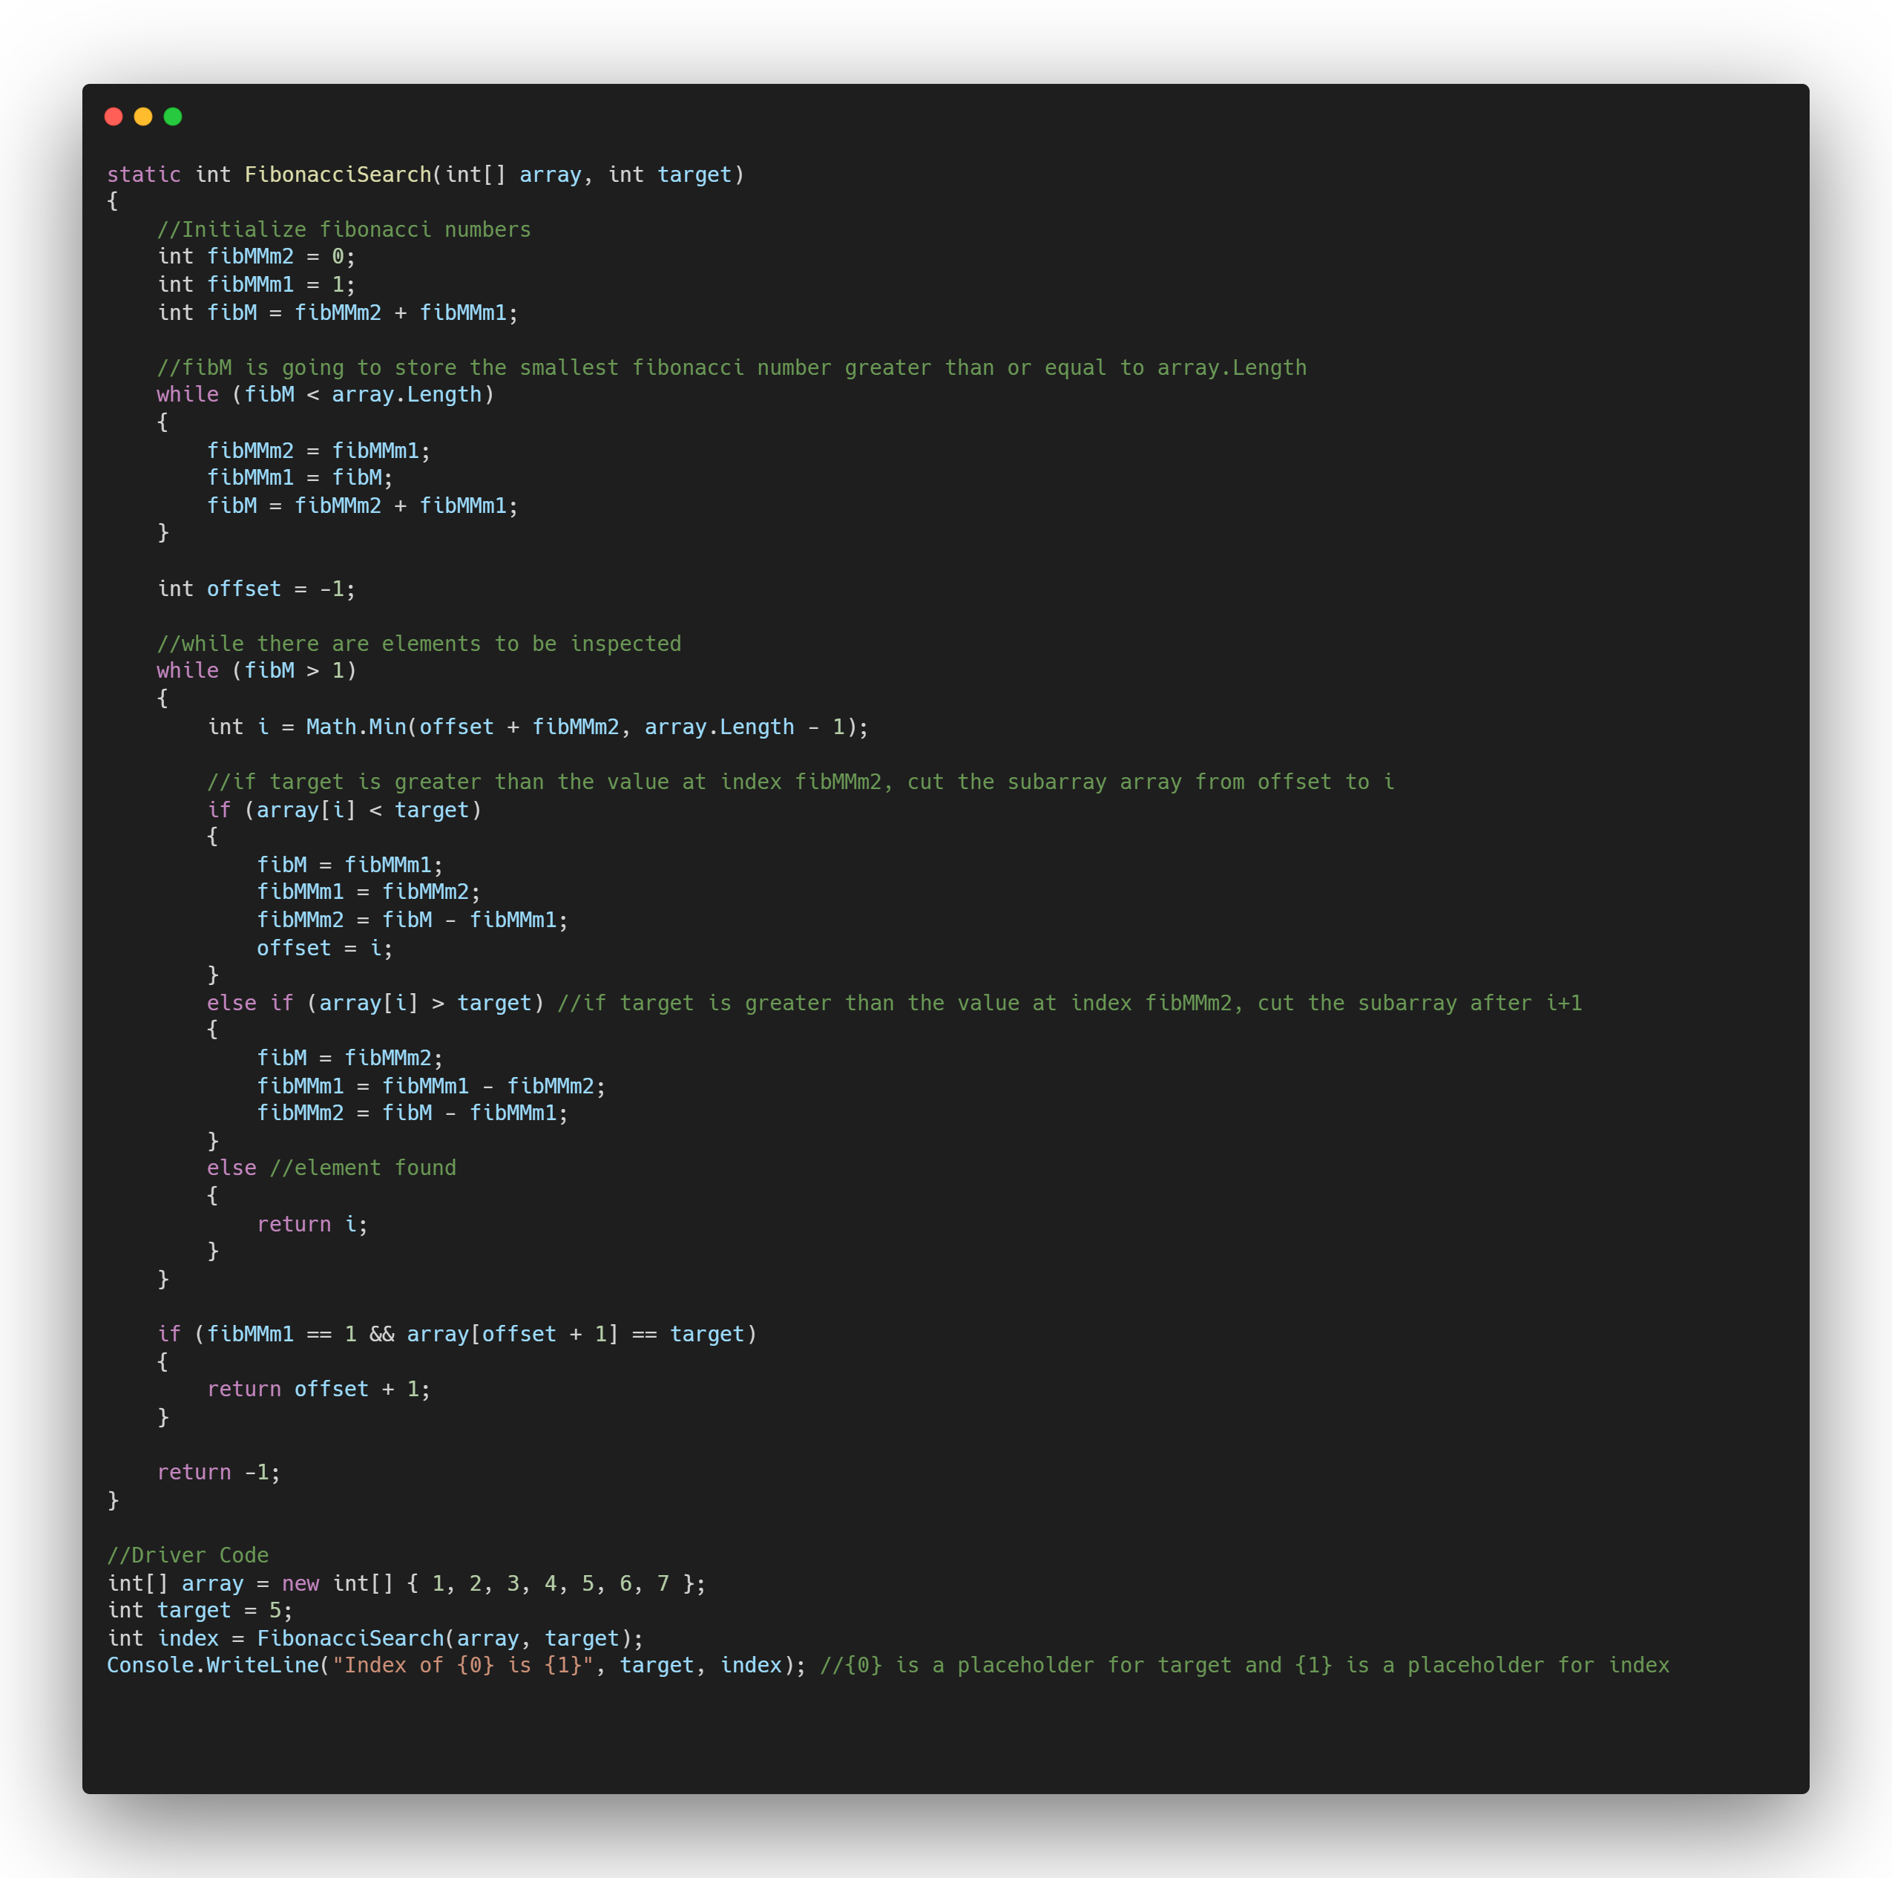
Visualization
Target: 80
Length: 9
Offset: 4
80
10
22
35
40
45
50
82
85
0
1
2
3
4
5
6
7
8
min(offset+Fm-2, n-1)
Target founded.
Input Size
CPU operations

Slide 13
Visualization
Target: 80
Length: 9
Offset: 4
80
10
22
35
40
45
50
82
85
0
1
2
3
4
5
6
7
8
min(offset+Fm-2, n-1)
Target founded.
Binary Search;
O(n)
Binary Search is defined as a searching algorithm used in a sorted array by repeatedly dividing the search interval in half. The idea of binary search is to use the information that the array is sorted and reduce the time complexity to O(log N).
How it works?
Time Complexity:
O(log n)
CPU operations
Divide the search space into two halves by finding the middle index.
Compare the middle element of the search space with the key.
If the key is found at middle element, the process is terminated.
If the key is not found at middle element, choose which half will be used as the next search space.
If the key is smaller than the middle element, then the left side is used for next search.
If the key is larger than the middle element, then the right side is used for next search.
This process is continued until the key is found or the total search space is done.
O(log n)
Input Size

Slide 14
Gunel Khanaliyeva
Binary Search;
Binary Search is defined as a searching algorithm used in a sorted array by repeatedly dividing the search interval in half. The idea of binary search is to use the information that the array is sorted and reduce the time complexity to O(log N).
How it works?
Divide the search space into two halves by finding the middle index.
Compare the middle element of the search space with the key.
If the key is found at middle element, the process is terminated.
If the key is not found at middle element, choose which half will be used as the next search space.
If the key is smaller than the middle element, then the left side is used for next search.
If the key is larger than the middle element, then the right side is used for next search.
This process is continued until the key is found or the total search space is done.

Slide 15
Binary Search;
Binary Search is defined as a searching algorithm used in a sorted array by repeatedly dividing the search interval in half. The idea of binary search is to use the information that the array is sorted and reduce the time complexity to O(log N).
How it works?
Divide the search space into two halves by finding the middle index.
Compare the middle element of the search space with the key.
If the key is found at middle element, the process is terminated.
If the key is not found at middle element, choose which half will be used as the next search space.
If the key is smaller than the middle element, then the left side is used for next search.
If the key is larger than the middle element, then the right side is used for next search.
This process is continued until the key is found or the total search space is done.
Visualization
Target: 80
Length: 9
Mid: 4
45
10
22
35
40
50
80
82
85
0
1
2
3
4
5
6
7
8
Find mid point
floor(8+0/2) = 4

Slide 16
Binary Search;
Binary Search is defined as a searching algorithm used in a sorted array by repeatedly dividing the search interval in half. The idea of binary search is to use the information that the array is sorted and reduce the time complexity to O(log N).
How it works?
Divide the search space into two halves by finding the middle index.
Compare the middle element of the search space with the key.
If the key is found at middle element, the process is terminated.
If the key is not found at middle element, choose which half will be used as the next search space.
If the key is smaller than the middle element, then the left side is used for next search.
If the key is larger than the middle element, then the right side is used for next search.
This process is continued until the key is found or the total search space is done.
Visualization
Target: 80
Length: 9
Mid: 4
50
80
82
85
10
22
35
40
45
0
1
2
3
4
5
6
7
8
Target is Higher than Key Value.

Slide 17
Binary Search;
Binary Search is defined as a searching algorithm used in a sorted array by repeatedly dividing the search interval in half. The idea of binary search is to use the information that the array is sorted and reduce the time complexity to O(log N).
How it works?
Divide the search space into two halves by finding the middle index.
Compare the middle element of the search space with the key.
If the key is found at middle element, the process is terminated.
If the key is not found at middle element, choose which half will be used as the next search space.
If the key is smaller than the middle element, then the left side is used for next search.
If the key is larger than the middle element, then the right side is used for next search.
This process is continued until the key is found or the total search space is done.
Visualization
Target: 80
Length: 9
Mid: 4
80
10
22
35
40
45
50
82
85
0
1
2
3
4
5
6
7
8
Find mid point
floor(8+5/2) = 6

Slide 18
Visualization
Target: 80
Length: 9
Mid: 4
80
10
22
35
40
45
50
82
85
0
1
2
3
4
5
6
7
8
Target is Equal to Key Value
Input Size
CPU operations

Slide 19
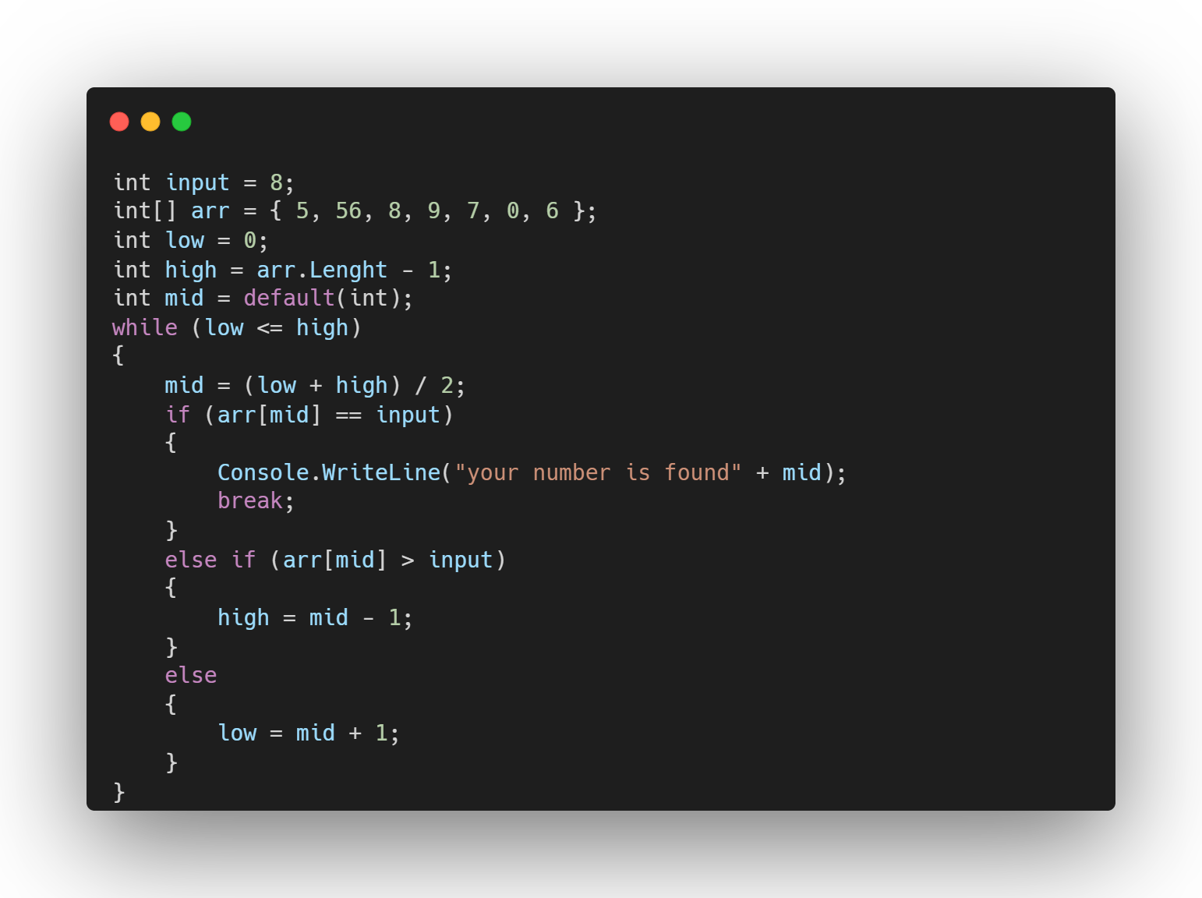
Visualization
Target: 80
Length: 9
Mid: 4
80
10
22
35
40
45
50
82
85
0
1
2
3
4
5
6
7
8
Target is Equal to Key Value
Input Size
CPU operations

Slide 20
Visualization
Target: 80
Length: 9
Mid: 4
80
10
22
35
40
45
50
82
85
0
1
2
3
4
5
6
7
8
Target is Equal to Key Value
Jump Search;
O(n)
Jump Search is a searching algorithm for sorted arrays. The basic idea is to check fewer elements (than linear search) by jumping ahead by fixed steps or skipping some elements in place of searching all elements.
How it works?
Time Complexity:
O(log n)
CPU operations
The steps are determined by the Square Root of the length of the array.
Here is a step-by-step algorithm for the jump search:
Determine the step size m by taking the sqrt of the length of the array n.
Start at the first element of the array and jump m steps until the value at that position is greater than the target value.
Once a value greater than the target is found, perform a linear search starting from the previous step until the target is found or it is clear that the target is not in the array.
If the target is found, return its index. If not, return -1 to indicate that the target was not found in the array.
O(log n)
Input Size

Slide 21
Zivar Hasanova
Jump Search;
Jump Search is a searching algorithm for sorted arrays. The basic idea is to check fewer elements (than linear search) by jumping ahead by fixed steps or skipping some elements in place of searching all elements.
How it works?
The steps are determined by the Square Root of the length of the array.
Here is a step-by-step algorithm for the jump search:
Determine the step size m by taking the sqrt of the length of the array n.
Start at the first element of the array and jump m steps until the value at that position is greater than the target value.
Once a value greater than the target is found, perform a linear search starting from the previous step until the target is found or it is clear that the target is not in the array.
If the target is found, return its index. If not, return -1 to indicate that the target was not found in the array.

Slide 22
Jump Search;
Jump Search is a searching algorithm for sorted arrays. The basic idea is to check fewer elements (than linear search) by jumping ahead by fixed steps or skipping some elements in place of searching all elements.
How it works?
The steps are determined by the Square Root of the length of the array.
Here is a step-by-step algorithm for the jump search:
Determine the step size m by taking the sqrt of the length of the array n.
Start at the first element of the array and jump m steps until the value at that position is greater than the target value.
Once a value greater than the target is found, perform a linear search starting from the previous step until the target is found or it is clear that the target is not in the array.
If the target is found, return its index. If not, return -1 to indicate that the target was not found in the array.
Visualization
Target: 80
Length: 9
Steps: 3
10
22
35
40
45
50
80
82
85
0
1
2
3
4
5
6
7
8
Find Step Size: sqrt(Length) = 3

Slide 23
Jump Search;
Jump Search is a searching algorithm for sorted arrays. The basic idea is to check fewer elements (than linear search) by jumping ahead by fixed steps or skipping some elements in place of searching all elements.
How it works?
The steps are determined by the Square Root of the length of the array.
Here is a step-by-step algorithm for the jump search:
Determine the step size m by taking the sqrt of the length of the array n.
Start at the first element of the array and jump m steps until the value at that position is greater than the target value.
Once a value greater than the target is found, perform a linear search starting from the previous step until the target is found or it is clear that the target is not in the array.
If the target is found, return its index. If not, return -1 to indicate that the target was not found in the array.
Visualization
Target: 80
Length: 9
Steps: 3
10
22
35
40
45
50
80
82
85
0
8
1
2
3
4
5
6
7
8
Start from index: 0 Jump by 3 steps

Slide 24
Jump Search;
Jump Search is a searching algorithm for sorted arrays. The basic idea is to check fewer elements (than linear search) by jumping ahead by fixed steps or skipping some elements in place of searching all elements.
How it works?
The steps are determined by the Square Root of the length of the array.
Here is a step-by-step algorithm for the jump search:
Determine the step size m by taking the sqrt of the length of the array n.
Start at the first element of the array and jump m steps until the value at that position is greater than the target value.
Once a value greater than the target is found, perform a linear search starting from the previous step until the target is found or it is clear that the target is not in the array.
If the target is found, return its index. If not, return -1 to indicate that the target was not found in the array.
Visualization
Target: 80
Length: 9
Steps: 3
40
45
50
10
22
35
80
82
85
0
8
1
2
3
4
5
6
7
8
Target is higher than key value Switch to next block

Slide 25
Jump Search;
Jump Search is a searching algorithm for sorted arrays. The basic idea is to check fewer elements (than linear search) by jumping ahead by fixed steps or skipping some elements in place of searching all elements.
How it works?
The steps are determined by the Square Root of the length of the array.
Here is a step-by-step algorithm for the jump search:
Determine the step size m by taking the sqrt of the length of the array n.
Start at the first element of the array and jump m steps until the value at that position is greater than the target value.
Once a value greater than the target is found, perform a linear search starting from the previous step until the target is found or it is clear that the target is not in the array.
If the target is found, return its index. If not, return -1 to indicate that the target was not found in the array.
Visualization
Target: 80
Length: 9
Steps: 3
80
82
85
10
22
35
40
45
50
0
1
2
3
4
5
6
7
8
Target is lower than key value
Do linear search.

Slide 26
Visualization
Target: 80
Length: 9
Steps: 3
80
10
22
35
40
45
50
82
85
0
1
2
3
4
5
6
7
8
Target has been found in first iterate.
Input Size
CPU operations

Slide 27
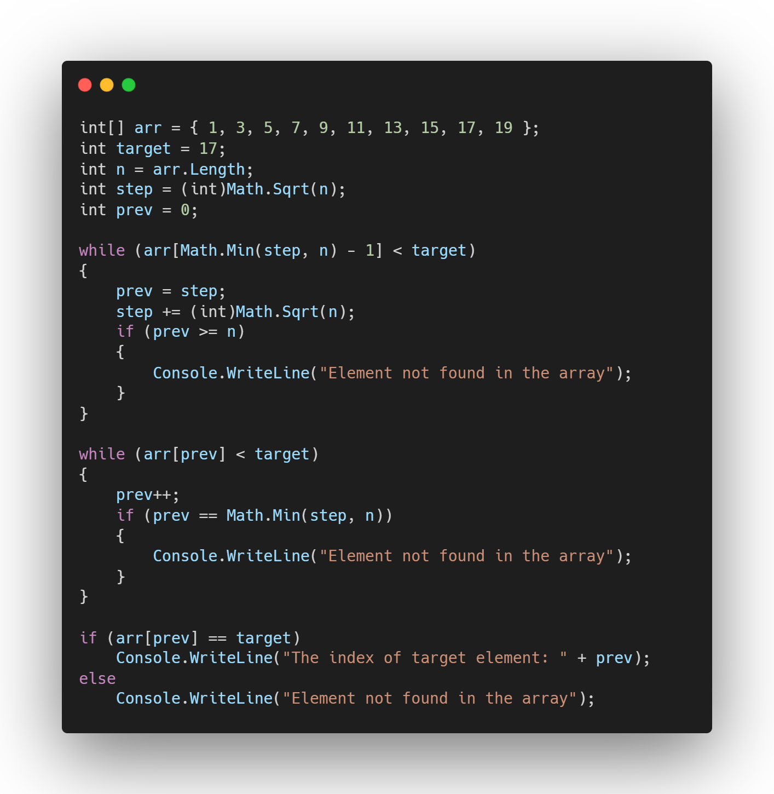
Visualization
Target: 80
Length: 9
Steps: 3
80
10
22
35
40
45
50
82
85
0
1
2
3
4
5
6
7
8
Target has been found in first iterate.
Input Size
CPU operations

Slide 28
Visualization
Target: 80
Length: 9
Steps: 3
80
10
22
35
40
45
50
82
85
0
1
2
3
4
5
6
7
8
Target has been found in first iterate.
Time Complexity:
O(sqrt n)
O(n)
CPU operations
O(sqrt n)
O(log n)
Input Size

Slide 29
Javidan Alizada
Ternary Search;
Ternary search is a decrease and conquer algorithm that can be used to find an element in an array. It is similar to binary search where we divide the array into two parts but in this algorithm, we divide the given array into three parts and determine which has the key.
How it works?
First, we compare the key with the element at mid1. If found equal, we return mid1.
If not, then we compare the key with the element at mid2. If found equal, we return mid2.
If not, then we check whether the key is less than the element at mid1. If yes, then recur to the first part.
If not, then we check whether the key is greater than the element at mid2. If yes, then recur to the third part.
If not, then we recur to the second part.

Slide 30
Ternary Search;
Ternary search is a decrease and conquer algorithm that can be used to find an element in an array. It is similar to binary search where we divide the array into two parts but in this algorithm, we divide the given array into three parts and determine which has the key.
How it works?
First, we compare the key with the element at mid1. If found equal, we return mid1.
If not, then we compare the key with the element at mid2. If found equal, we return mid2.
If not, then we check whether the key is less than the element at mid1. If yes, then recur to the first part.
If not, then we check whether the key is greater than the element at mid2. If yes, then recur to the third part.
If not, then we recur to the second part.
Visualization
Target: 50
Length: 9
Steps: 3
l
r
10
22
35
40
45
50
80
82
85
0
1
2
3
4
5
6
7
8
Mid1
= floor(l + (r-l)/3) = 2
= floor(r - (r-l)/3) = 6
Mid2

Slide 31
Ternary Search;
Ternary search is a decrease and conquer algorithm that can be used to find an element in an array. It is similar to binary search where we divide the array into two parts but in this algorithm, we divide the given array into three parts and determine which has the key.
How it works?
First, we compare the key with the element at mid1. If found equal, we return mid1.
If not, then we compare the key with the element at mid2. If found equal, we return mid2.
If not, then we check whether the key is less than the element at mid1. If yes, then recur to the first part.
If not, then we check whether the key is greater than the element at mid2. If yes, then recur to the third part.
If not, then we recur to the second part.
Visualization
Target: 50
Length: 9
Steps: 3
Mid1
l
35
Mid2
r
10
22
40
45
50
80
82
85
0
1
2
3
4
5
6
7
8
Compare target with Mid1 Target > Mid1

Slide 32
Ternary Search;
Ternary search is a decrease and conquer algorithm that can be used to find an element in an array. It is similar to binary search where we divide the array into two parts but in this algorithm, we divide the given array into three parts and determine which has the key.
How it works?
First, we compare the key with the element at mid1. If found equal, we return mid1.
If not, then we compare the key with the element at mid2. If found equal, we return mid2.
If not, then we check whether the key is less than the element at mid1. If yes, then recur to the first part.
If not, then we check whether the key is greater than the element at mid2. If yes, then recur to the third part.
If not, then we recur to the second part.
Visualization
Target: 50
Length: 9
Steps: 3
Mid2
l
Mid1
80
r
10
22
35
40
45
50
82
85
0
1
2
3
4
5
6
7
8
Compare target with Mid2 Target < Mid2

Slide 33
Ternary Search;
Ternary search is a decrease and conquer algorithm that can be used to find an element in an array. It is similar to binary search where we divide the array into two parts but in this algorithm, we divide the given array into three parts and determine which has the key.
How it works?
First, we compare the key with the element at mid1. If found equal, we return mid1.
If not, then we compare the key with the element at mid2. If found equal, we return mid2.
If not, then we check whether the key is less than the element at mid1. If yes, then recur to the first part.
If not, then we check whether the key is greater than the element at mid2. If yes, then recur to the third part.
If not, then we recur to the second part.
Visualization
Target: 50
Length: 9
Steps: 3
Mid1
l
r
Mid2
10
22
35
40
45
50
80
82
85
0
1
2
3
4
5
6
7
8
Recur to second part Center of Mid1 and Mid2

Slide 34
Ternary Search;
Ternary search is a decrease and conquer algorithm that can be used to find an element in an array. It is similar to binary search where we divide the array into two parts but in this algorithm, we divide the given array into three parts and determine which has the key.
How it works?
First, we compare the key with the element at mid1. If found equal, we return mid1.
If not, then we compare the key with the element at mid2. If found equal, we return mid2.
If not, then we check whether the key is less than the element at mid1. If yes, then recur to the first part.
If not, then we check whether the key is greater than the element at mid2. If yes, then recur to the third part.
If not, then we recur to the second part.
Visualization
Target: 50
Length: 9
Steps: 3
l
r
10
22
35
40
45
50
80
82
85
0
1
2
3
4
5
6
7
8
Mid1
= floor(l + (r-l)/3) = 3
= floor(r - (r-l)/3) = 5
Mid2

Slide 35
Ternary Search;
Ternary search is a decrease and conquer algorithm that can be used to find an element in an array. It is similar to binary search where we divide the array into two parts but in this algorithm, we divide the given array into three parts and determine which has the key.
How it works?
First, we compare the key with the element at mid1. If found equal, we return mid1.
If not, then we compare the key with the element at mid2. If found equal, we return mid2.
If not, then we check whether the key is less than the element at mid1. If yes, then recur to the first part.
If not, then we check whether the key is greater than the element at mid2. If yes, then recur to the third part.
If not, then we recur to the second part.
Visualization
Target: 50
Length: 9
Steps: 3
l
Mid1
r
40
Mid2
10
22
35
45
50
80
82
85
0
1
2
3
4
5
6
7
8
Compare target with Mid1 Target > Mid1

Slide 36
Ternary Search;
Ternary search is a decrease and conquer algorithm that can be used to find an element in an array. It is similar to binary search where we divide the array into two parts but in this algorithm, we divide the given array into three parts and determine which has the key.
How it works?
First, we compare the key with the element at mid1. If found equal, we return mid1.
If not, then we compare the key with the element at mid2. If found equal, we return mid2.
If not, then we check whether the key is less than the element at mid1. If yes, then recur to the first part.
If not, then we check whether the key is greater than the element at mid2. If yes, then recur to the third part.
If not, then we recur to the second part.
Visualization
Target: 50
Length: 9
Steps: 3
r
l
Mid2
Mid1
50
10
22
35
40
45
80
82
85
0
1
2
3
4
5
6
7
8
Compare target with Mid2 Target = Mid2

Slide 37
Ternary Search;
Ternary search is a decrease and conquer algorithm that can be used to find an element in an array. It is similar to binary search where we divide the array into two parts but in this algorithm, we divide the given array into three parts and determine which has the key.
How it works?
First, we compare the key with the element at mid1. If found equal, we return mid1.
If not, then we compare the key with the element at mid2. If found equal, we return mid2.
If not, then we check whether the key is less than the element at mid1. If yes, then recur to the first part.
If not, then we check whether the key is greater than the element at mid2. If yes, then recur to the third part.
If not, then we recur to the second part.
Visualization
Target: 50
Length: 9
Steps: 3
r
l
Mid2
Mid1
50
10
22
35
40
45
80
82
85
0
1
2
3
4
5
6
7
8
Target found in
Mid2’s pointer.
Input Size
CPU operations

Slide 38
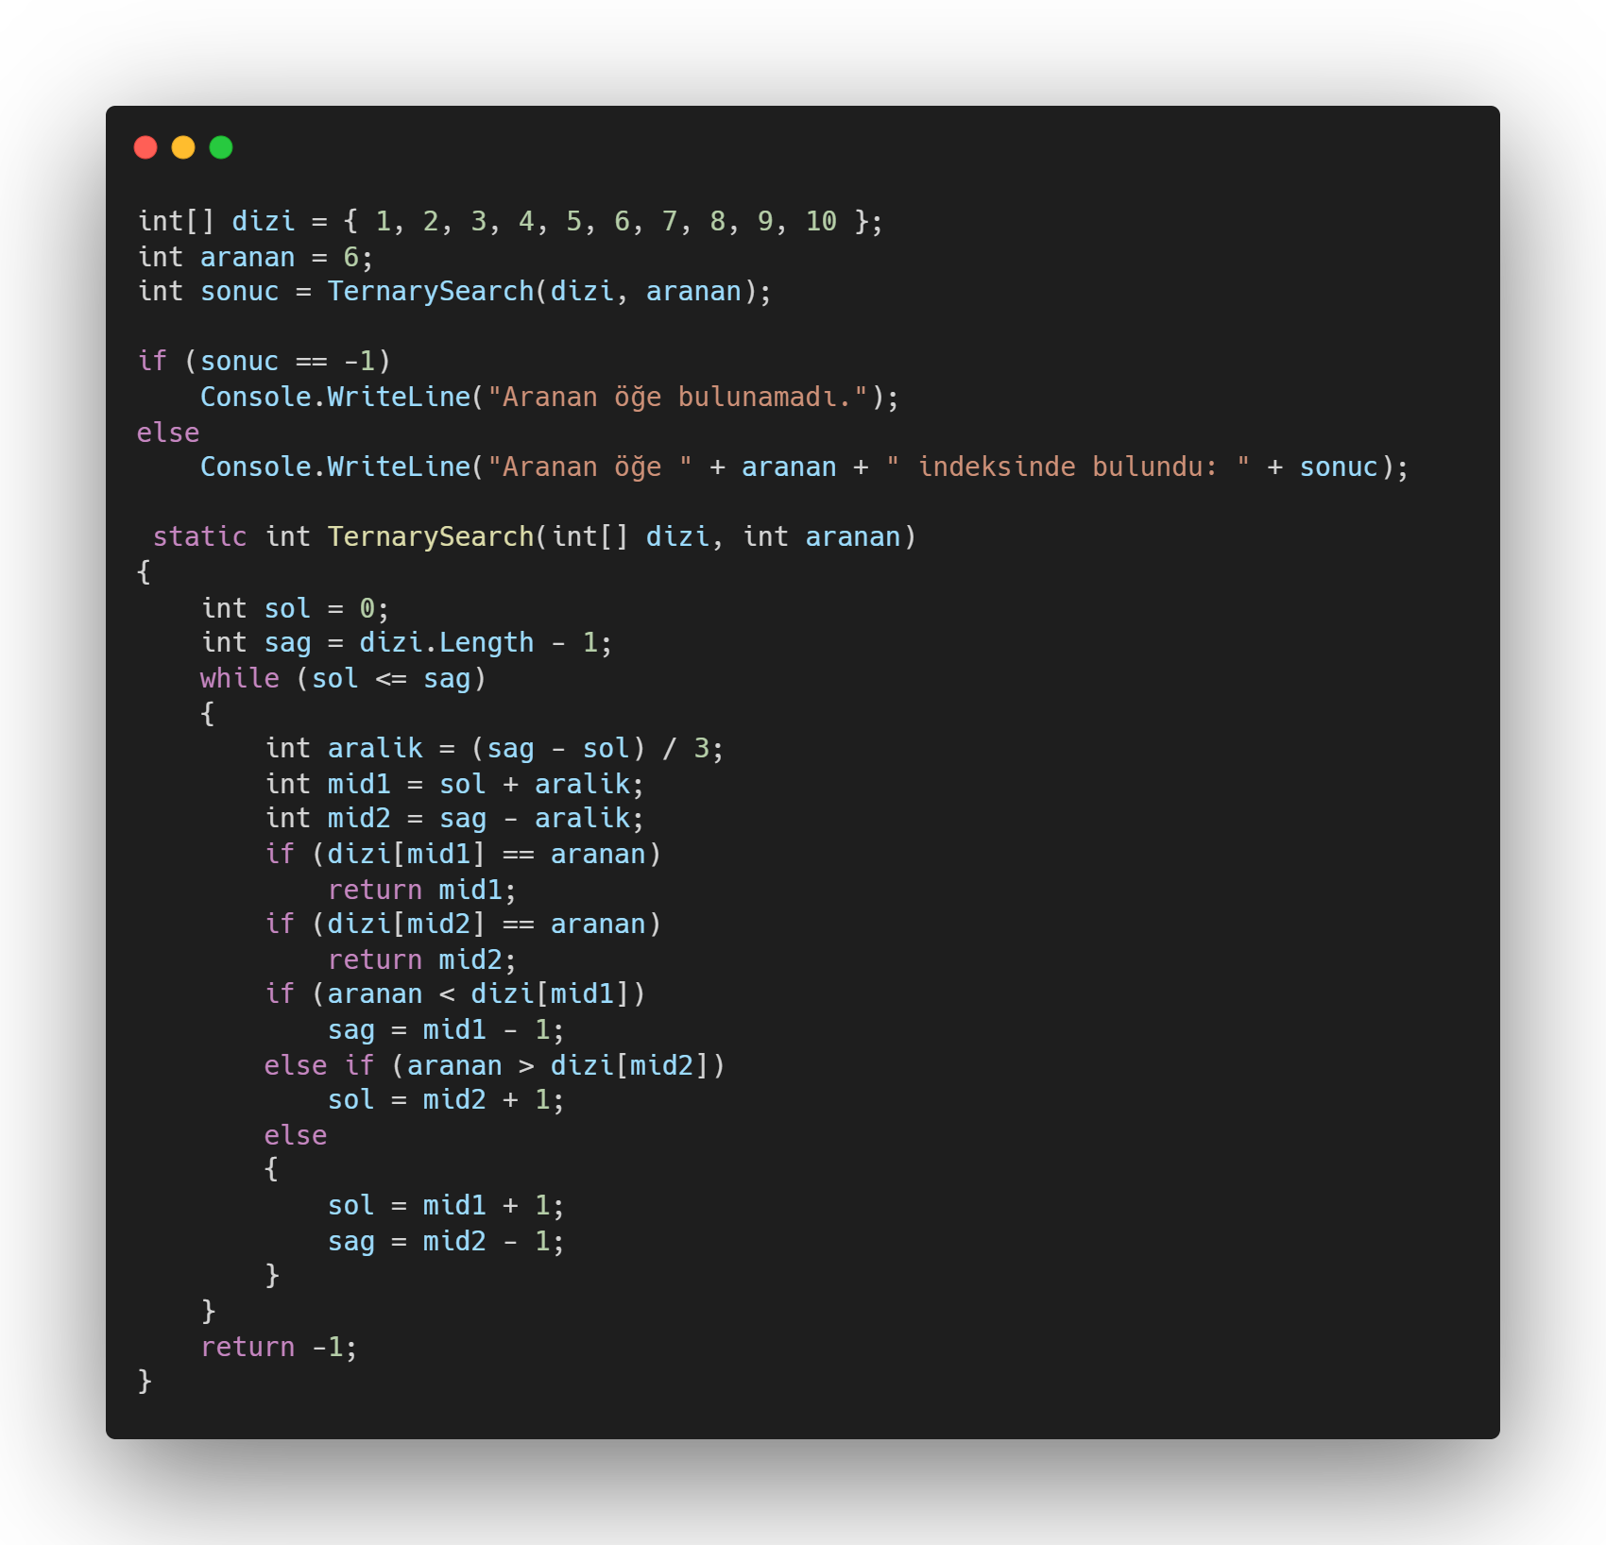
Visualization
Target: 50
Length: 9
Steps: 3
r
l
Mid2
Mid1
50
10
22
35
40
45
80
82
85
0
1
2
3
4
5
6
7
8
Target found in
Mid2’s pointer.
Input Size
CPU operations

Slide 39
Visualization
Target: 80
Length: 9
Steps: 3
80
10
22
35
40
45
50
82
85
0
1
2
3
4
5
6
7
8
Target has been found in first iterate.
Time Complexity:
O(log3n)
O(n)
CPU operations
O(sqrt n)
O(log n)
O(log3n)
Input Size

Slide 40
End Of Searching Algorithms Thank you for listening! :3
Codes can be found in my Repo: https://github.com/AVMiraga/Sorting_And_Searching

